Slide 1
Introduction to Java AWT and Java Swing
Course: 2198-CSE-4361-001-SOFTWARE DESIGN PATTERNS
Radhika Junitipaly

Slide 2
Java AWT and Java Swing
Java AWT is an API to develop window-based applications in java.
From Oracle docs Description of AWT API:
AWT API contains all the classes for creating user interfaces and for painting graphics and images.
Java Swing is also used to create window-based applications, it is built on top of AWT
From Oracle docs Description of Swing API:
Provides a set of "lightweight" (all-Java language) components that, to the maximum degree possible, work the same on all platforms.

Slide 3
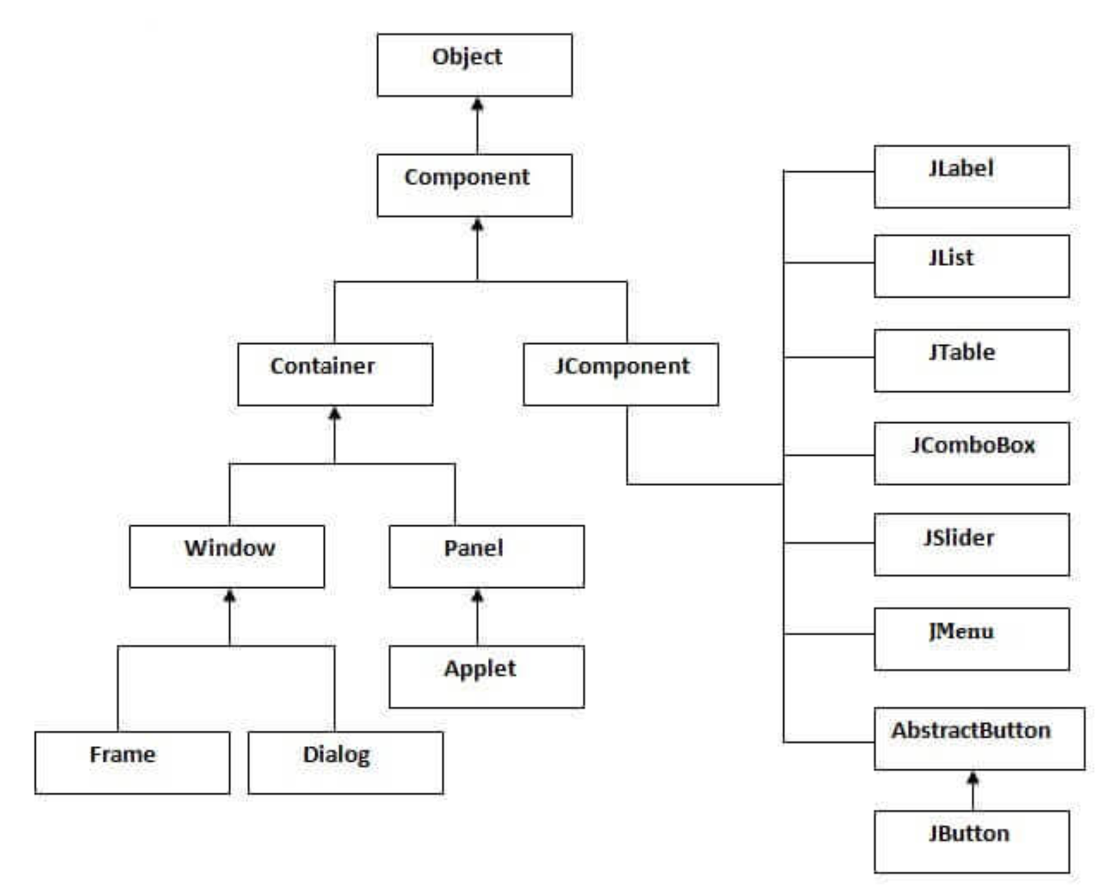
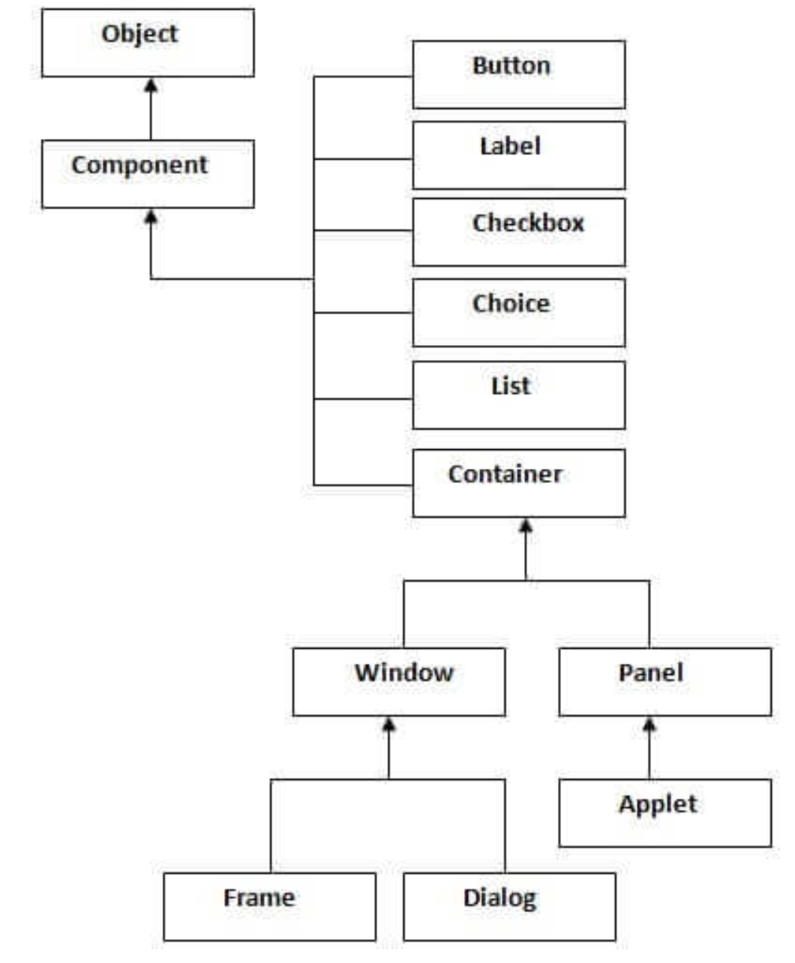
Heirarchy of Java swing API
Heirarchy of Java AWT API

Slide 4
Difference between AWT and Swing
Java AWT | Java Swing
AWT components are platform-dependent. | Java swing components are platform-independent.
AWT components are heavyweight. | Swing components are lightweight.
AWT doesn't support pluggable look and feel. | Swing supports pluggable look and feel.
AWT provides less components than Swing. | Swing provides more powerful components such as tables, lists, scrollpanes, colorchooser, tabbedpane etc.
AWT doesn't follows MVC | Swing follows MVC.

Slide 5
Java JFrame
The javax.swing.JFrame class is a type of container which inherits the java.awt.Frame class.
JFrame works like the main window where components like labels, buttons, textfields are added to create a GUI.
Unlike Frame, JFrame has the option to hide or close the window with the help of setDefaultCloseOperation(int) method.
To create a JFrame object :
JFrame()
JFrame(String title)
BorderLayout is the default layout in JFrame.

Slide 6
Create a Frame/JFrame
There are two ways to create a Frame/JFrame:
By creating the object of Frame/JFrame class (association)
New Frame();
By extending Frame/JFrame class (inheritance)
Class MyFrame extends Frame() {….}

Slide 7
Java AWT simple example
import java.awt.*;
class HelloWorld extends Frame {
HelloWorld() {
Button b=new Button(“Hello world");
// setting button position
b.setBounds(30,100,80,30);
//adding button into frame
add(b);
//frame size 1400 width and 600 height
setBounds(10, 10, 1400, 600);
//no layout manager
setLayout(null);
//now frame will be visible, by default not visible
setVisible(true);
}
public static void main(String[] args) {
new HelloWorld();
}
}
import java.awt.*;
class HelloWorld {
HelloWorld() {
Frame f=new Frame();
Button b=new Button(“Hello world");
b.setBounds(30,50,80,30);
f.add(b);
f.setSize(300,300);
f.setLayout(null);
f.setVisible(true);
}
public static void main(String args[]) {
new HelloWorld();
}
}

Slide 8
Java swing example
import javax.swing.*;
public class HelloWorld {
public static void main(String[] args) {
//creating instance of JFrame
JFrame frame=new JFrame(“My First Frame”);
//creating instance of JButton
JButton button=new JButton(“Hello World");
//x axis, y axis, width, height
button.setBounds(130,100,100, 40);
frame.add(button); //adding button in JFrame
frame.setSize(400,500); //400 width and 500 height
frame.setLayout(null); //using no layout managers
frame.setVisible(true); //making the frame visible
}
}

Slide 9
Create a button
Border buttonBorder = BorderFactory.createLineBorder(Color.BLACK, 5, true);
circleButton = new JButton("Circle");
circleButton.setFont(new Font("Arial", Font.PLAIN, 40));
circleButton.setPreferredSize(new Dimension(200, 70));
circleButton.setBorder(buttonBorder);

Slide 10
Event and Listener
Event is changing the state of an object
Button click
Mouse drag
Mouse click
Events and listeners, you will be using for your HW1:
ActionEvent and ActionListener
MouseEvent and MouseListener

Slide 11
ActionEvent and ActionListener example
class MyFrame extends Frame{
MyFrame() {
……….
Button button=new Button("click me");
button.setBounds(50,120,80,30);
button.addActionListener(new ActionListener(){
public void actionPerformed(ActionEvent e){
//You might want to highlight the button you have clicked on
button.setFont(new Font("Arial", Font.BOLD, 40));
//Other logic follows
…..
}
});
add(button);
……….
}
public static void main(String args[]){
new MyFrame();
}
}

Slide 12
Java JPanel
The JPanel is a simplest container class.
It provides space in which an application can attach any other component.
It inherits the JComponents class.
It doesn't have title bar.
To create a JPanel object :
new JPanel()
You would be using a BorderLayout for your HW, so that Panel that contains buttons can be added to left side.
code:
frame.add(buttonsPanel, BorderLayout.west)

Slide 13
Code with JPanel
import javax.swing.*;
public class HelloWorld {
public static void main(String[] args) {
JFrame frame=new JFrame(“My First Frame”);
JPanel buttonsPanel = new JPanel();
JPanel drawingAreaPanel = new JPanel();
JButton button=new JButton(“Hello World");
button.setBounds(130,100,100, 40);
buttonsPanel.add(button); //adding button in JPanel
frame.add(buttonsPanel, BorderLayout.WEST);
frame.add(drawingAreaPanel);
frame.setSize(400,500); //400 width and 500 height
frame.setLayout(null); //using no layout managers
frame.setVisible(true); //making the frame visible
}
}

Slide 14
Custom JPanel with MouseListener
When one of the buttons is clicked and then the mouse is pressed in the drawingAreaPanel, then the drawingAreaPanel should listen to the action and act as defined.
For this we will need a Panel with MouseListener, let’s create a custom class that extends JPanel

Slide 15
Custom JPanel with MouseListener
MouseAdapter is an Abstract class which implements MouseListener (and some other listeners too), mousePressed() is a null method define in MouseAdapter class which you will have to override and provide implementation for, as shown in the below example code.
class DrawAreaPanel extends JPanel {
private Point point = null;
public DrawAreaPanel() {
addMouseListener(new MouseAdapter() {
@Override
public void mousePressed(MouseEvent e) {
point = new Point(e.getX(), e.getY());
repaint();
}
}
});
}

Slide 16
Custom JPanel with MouseListener
The main reason for extending JPanel to create our custom DrawAreaPanel is to override the paintComponent method
Finally, override the paintComponent() method of Jpanel to get access to the Graphics class, which will be used to draw circles and/or squares to the panel.
I like to remember it this way:
JFrame is your easel
The JPanel is the canvas
the Graphics object is your paintbrush
super.paintComponent(g) is your eraser.
You can use Super.paintComponent(g) – to erase all shapes from the panel
Let’s look at the code to override the paintComponent() method

Slide 17
Custom JPanel with MouseListener
@Override
public void paintComponent(Graphics g) {
super.paintComponent(g);
if(point!=null) {
// Instantiate controller and ….??
…..
// Don’t forget to reset the highlighted button
}

Slide 18
Questions?

